Slide 1

G2M Case Study
Virtual Internship
18-JUNE-2024

Slide 2
Background –G2M(cab industry) case study
XYZ is a private equity firm in US. Due to remarkable growth in the Cab Industry in last few years and multiple key players in the market, it is planning for an investment in Cab industry.
Objective : Provide actionable insights to help XYZ firm in identifying the right company for making investment.
The analysis has consists of the following
Data Understanding .
Profit and ride forecasting.
Determining the more profitable investment.
Investment recommendations.

Slide 3
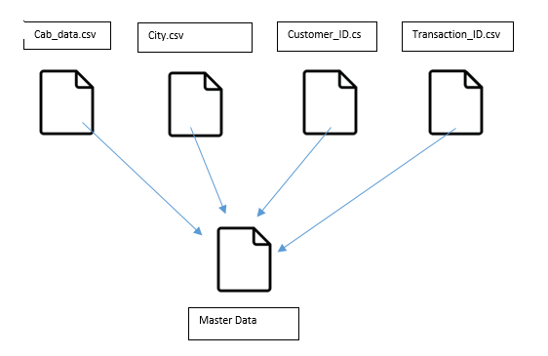
Data Exploration
16 Features( including 9 derived features)
Timeframe of data: 2016/01/31 to 2018/12/31
Total data points :359,391
Assumptions:
Only Price Charged and Cost of Trip columns were used to calculate profit, no considerations were made for other factors affecting profit.
Price Charged column contains outliers but due to
absence of trip duration data ,we did not consider outliers to be present.
Users column of the city dataset is treated was number of cab users in the city, the assumption is this can include other cab users besides the yellow and pink cab.

Slide 4
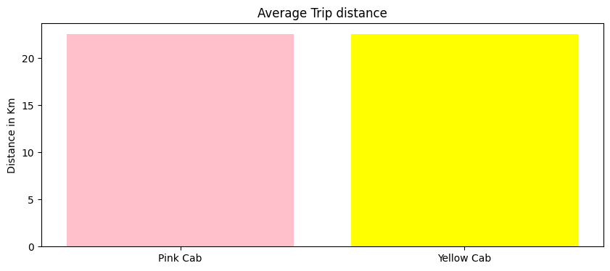
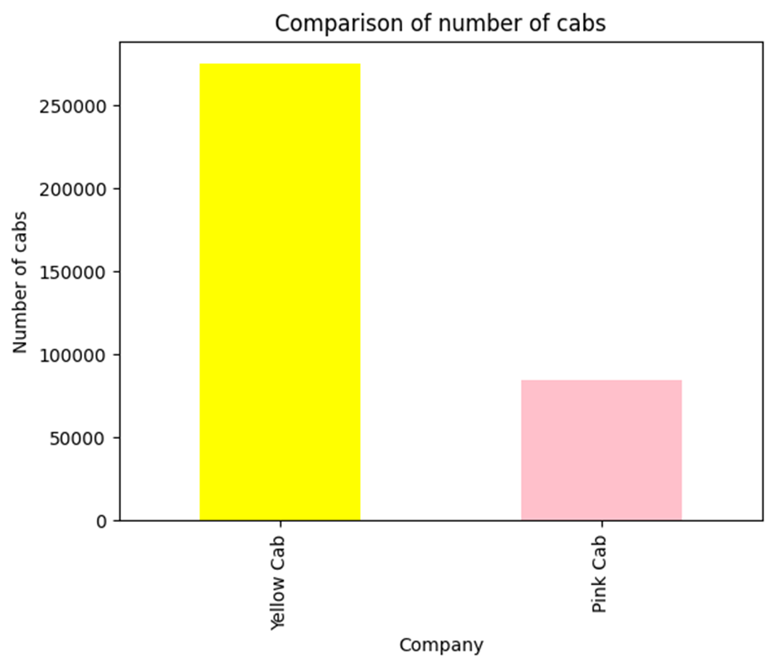
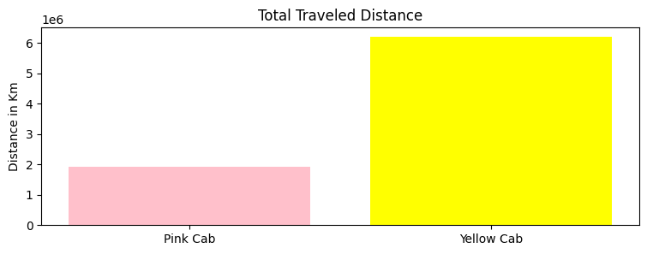
Company assets and scale of operations

Slide 5
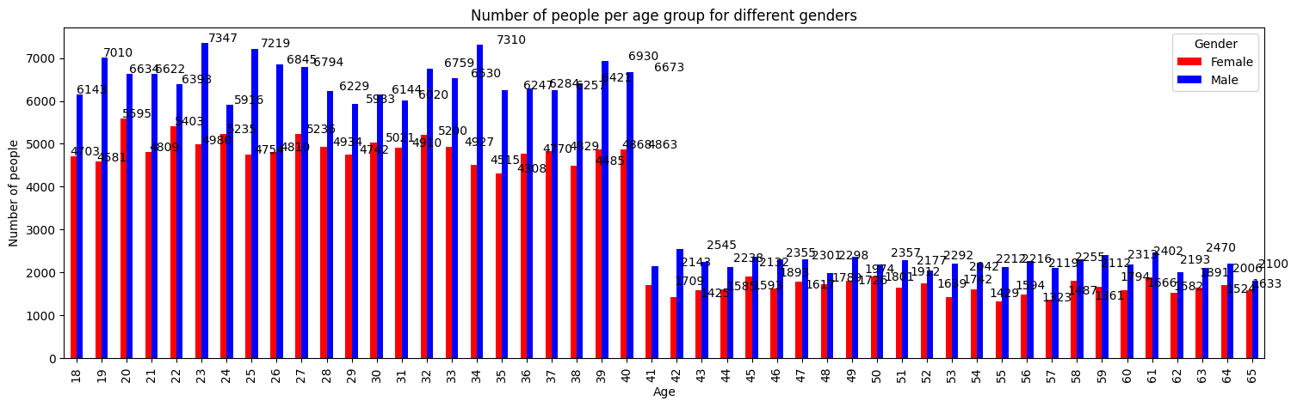
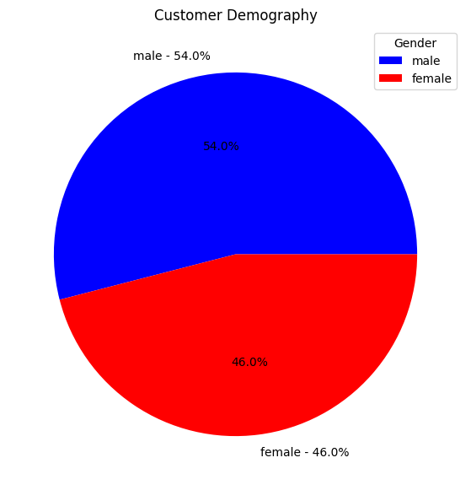
Customer demography analysis by age and gender

Slide 6
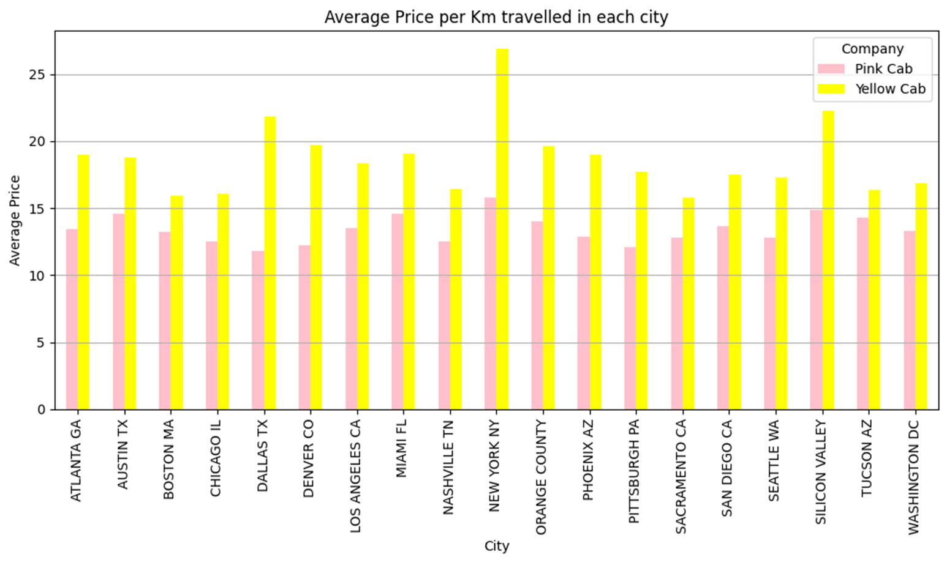
Average cost per unit distance for each company

Slide 7
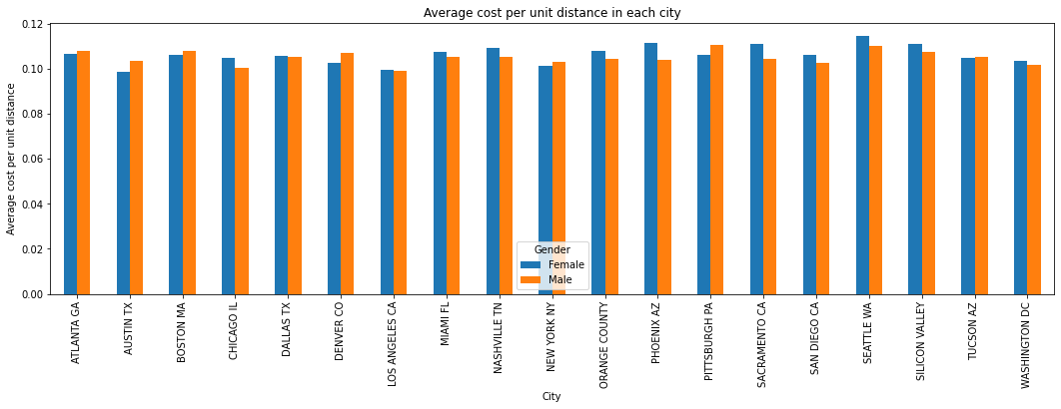
Average cost per unit distance in each city for each gender

Slide 8
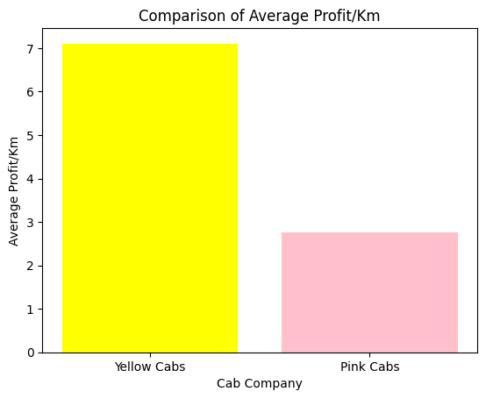
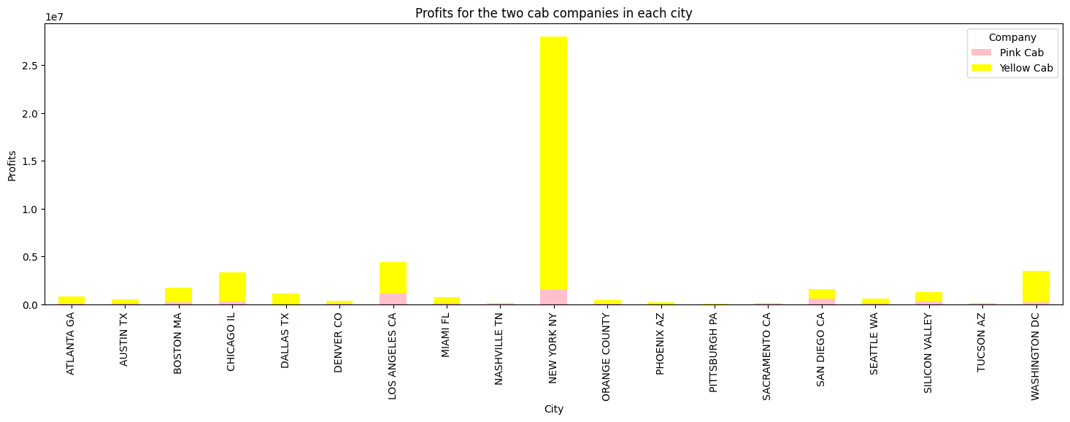
Profit Analysis

Slide 9
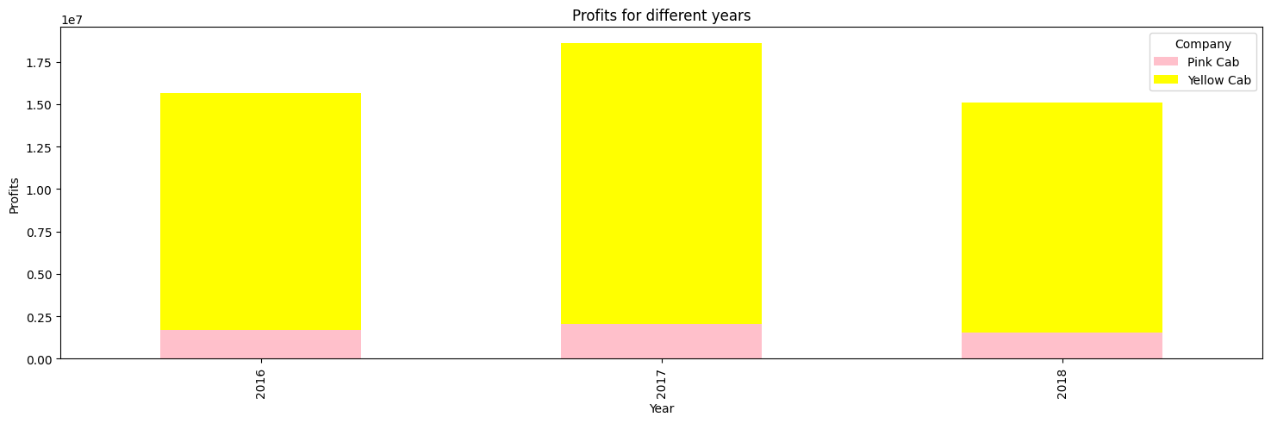
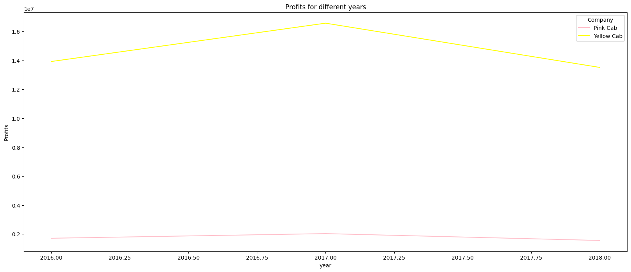
Yearly Profit Analysis

Slide 10
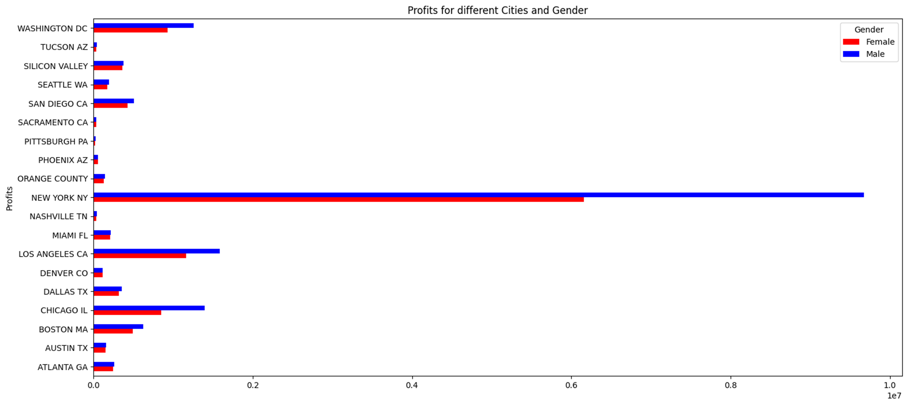
Analysis of profits for each city gender wise

Slide 11
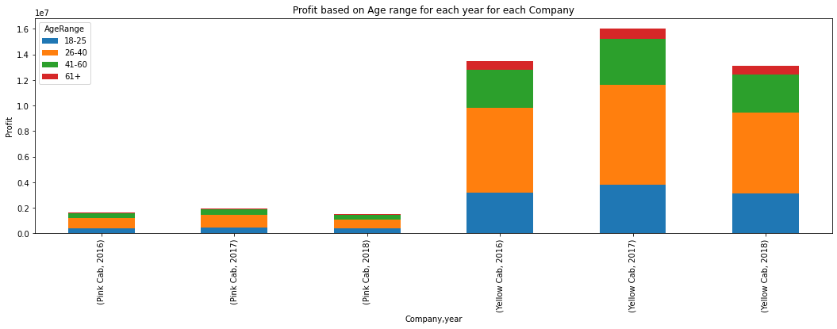
Yearly profit analysis for different age groups for each company

Slide 12
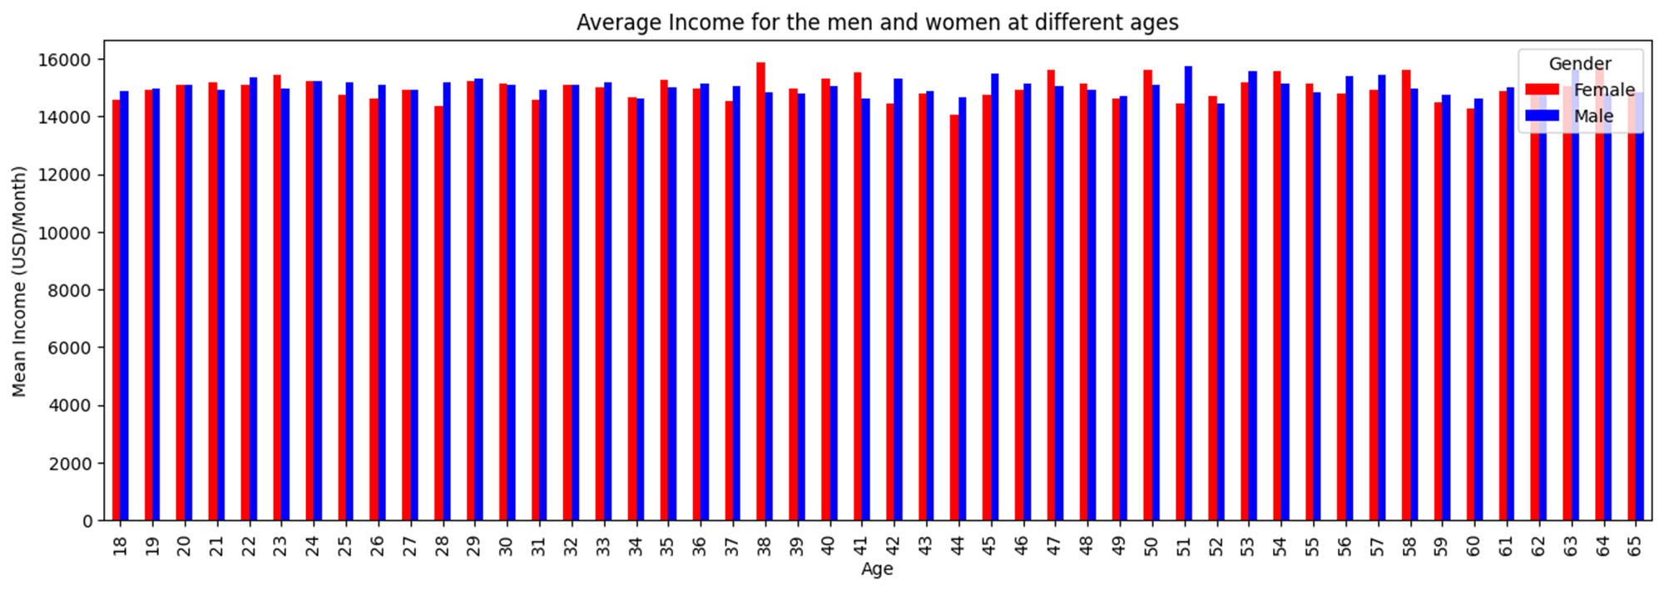
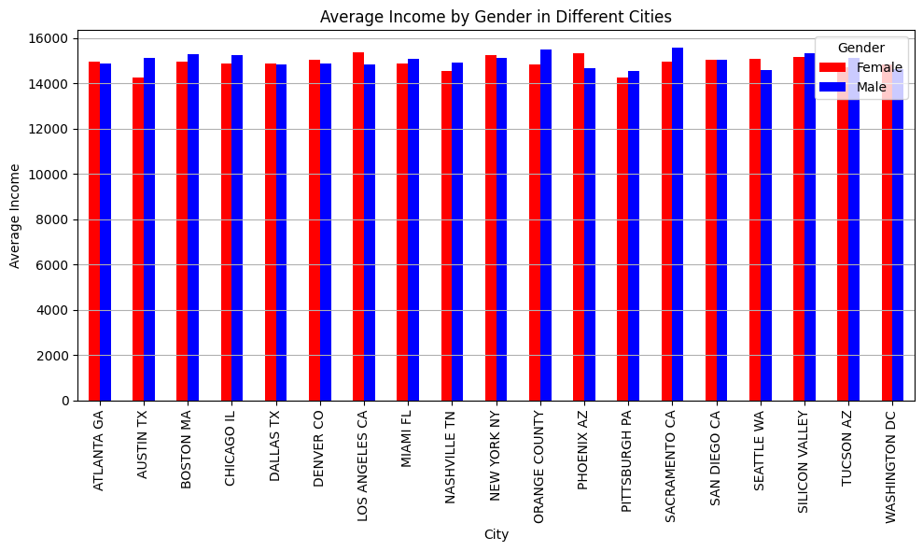
Income analysis for each city age and gender wise
Our analysis reveals that our customer base across different cities and age groups earn roughly the same salary (within the range $14,000-$16,000 USD/month) for both male and females, therefore there is no significant disparity in monthly income.

Slide 13
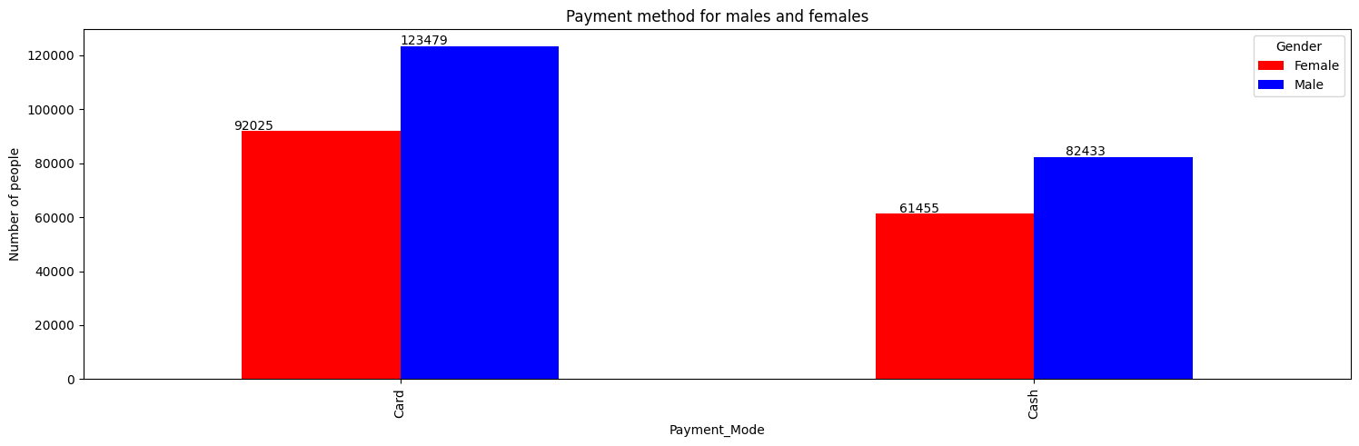
Analysis of payment methods for males and females

Slide 14
Recommendations
Our evaluation has lead us to the conclusion that the yellow can company is a better investment due to the following points
Average profit/Km: Yellow cab company charges more money per kilometer in every city when compared to pink company therefore yellow cab makes more profit per kilometer than pink cab.
Customer Reach : Yellow cab appears to own a greater market share of the cab industry evidenced by graph in slide 11(Yearly profit analysis for different age groups for each company) which shows that yellow cab has a greater customer base for every age group with the 26-40 years age group being the most prominent and profitable.
Customer Preference: In slide 4 we discover that yellow cab has significantly more total travel distance(about 3 times more) than pink cab, while the average trip distance for both companies is the same. This tells us that customers tend to prefer to ride with yellow cab as opposed to pink cab.
Profitability and growth : Yellow cab company profit appears to increase in from 2016 to 2017 and then decline in 2018, this is an indication of company growth. On the other hand pink company’s profits appear to be stagnant and no growth or decline is seen and this could be and indicator of poor management within the company.
Based on the above information, we will recommend Yellow cab company for investment.

Slide 15
Thank You

